Slide 1
CST 205 OOP :Core Java Fundamentals

Slide 2
SYLLABUS
Primitive Data types - Integers, Floating Point Types, Characters, Boolean. Literals, Type Conversion and Casting, Variables, Arrays, Strings, Vector class.
Operators - Arithmetic Operators, Bitwise Operators, Relational Operators, Boolean Logical Operators, Assignment Operator, Conditional (Ternary) Operator, Operator Precedence.
Control Statements - Selection Statements, Iteration Statements and Jump Statements
Object Oriented Programming in Java - Class Fundamentals, Declaring Objects, Object Reference, Introduction to Methods, Constructors, this Keyword, Method Overloading, Using Objects as Parameters, Returning Objects, Recursion, Access Control, Static Members, Final Variables, Inner Classes, Command Line Arguments, Variable Length Arguments.
Inheritance - Super Class, Sub Class, The Keyword super, protected Members, Calling Order of Constructors, Method Overriding, the Object class, Abstract Classes and Methods, using final with Inheritance.

Slide 3
OBJECTIVES
To explain about data types in java.
To give an overview of type conversion.
To introduce vector class.

Slide 4
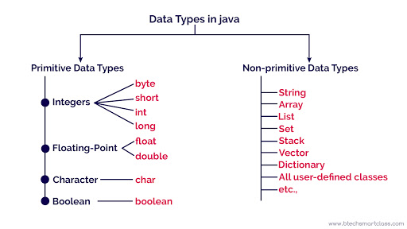
Data types In Java

Slide 5
Primitive Data types
Java defines eight primitive types of data.
byte
short
int
long
char
float
double
boolean

Slide 6
Primitive Data types
Integers :This group includes byte, short, int, and long, which are for whole-valued signed numbers.
Floating-point numbers: This group includes float and double, which represent numbers with fractional precision.
Characters :This group includes char, which represents symbols in a character set, like letters and numbers.
Boolean :This group includes boolean, which is a special type for representing true/false values.

Slide 7
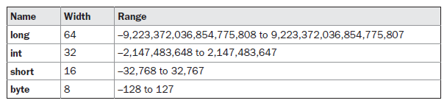
Primitive Data types
Integers.
Java defines four integer types: byte, short, int, and long. All of these are signed, positive and negative values.

Slide 8
Primitive Data types
Byte
The smallest integer type is byte.
This is a signed 8-bit type that has a range from –128 to 127.
Variables of type byte are especially useful when you’re working with a stream of data from a network or file. They are also useful when you’re working with raw binary data that may not be directly compatible with Java’s other built-in types.
Byte variables are declared by use of the byte keyword.
It's used instead of int or other integer data types to save memory if it's certain that the value of a variable will be within [-128, 127].
Default value: 0
For example
byte b, c;

Slide 9
Primitive Data types
Byte
class ByteExample
{
public static void main(String[] args)
{
byte range;
range = 124;
System.out.println(range);
}
}

Slide 10
Primitive Data types
short
short is a signed 16-bit type. It has a range from –32,768 to 32,767. It is probably the least-used Java type.
It's used instead of other integer data types to save memory if it's certain that the value of the variable will be within [-32768, 32767].
Default value: 0
Here are some examples of short variable declarations:
short s;
short t;

Slide 11
Primitive Data types
int
The most commonly used integer type is int.
It is a signed 32-bit type , a minimum value of -2³¹ and a maximum value of 2³¹-1.
Variables of type int are commonly employed to control loops and to index arrays.
The reason is that when byte and short values are used in an expression they are promoted to int when the expression is evaluated.
Therefore, int is often the best choice when an integer is needed.

Slide 12
Primitive Data types
long
long is a signed 64-bit type and is useful for those occasions where an int type is not large enough to hold the desired value.
The range of a long is quite large. This makes it useful when big, whole numbers are needed.
A minimum value of -2⁶³ and a maximum value of 2⁶³-1.
Floating-Point Types
Floating-point numbers, also known as real numbers, are used when evaluating expressions that require fractional precision.
For example, calculations such as square root, sine and cosine, result in a value whose precision requires a floating-point type.

Slide 13
Primitive Data types
class IntExample
{
public static void main(String[] args)
{
int range = -4250000;
System.out.println(range);
long longrange = -42332200000L;
System.out.println(range);
}
}

Slide 14

Primitive Data types
Floating-Point Types
Java implements the standard (IEEE–754) set of floating-point types and operators.
There are two kinds of floating-point types, float and double, which represent single- and double-precision numbers, respectively.
Their width and ranges are shown here:

Slide 15
Primitive Data types
float
The type float specifies a single-precision value that uses 32 bits of storage.
Variables of type float are useful when you need a fractional component, but don’t require a large degree of precision.
For example, float can be useful when representing dollars and cents.
Stores fractional numbers. Sufficient for storing 6 to 7 decimal digits
Here are some example float variable declarations:
float myFloatNum = 5.99f;

Slide 16
Primitive Data types
double
Double precision, as denoted by the double keyword, uses 64 bits to store a value. Sufficient for storing 15 decimal digits
Functions, such as sin( ), cos( ), and sqrt( ), return double values.
When you need to maintain accuracy over many iterative calculations, or are manipulating large-valued numbers, double is the best choice.
Default value: 0.0 (0.0d)
Both float and double data types were designed especially for scientific calculations, where approximation errors are acceptable. If accuracy is the most prior concern then, it is recommended not to use these data types and use BigDecimal class instead.

Slide 17
Primitive Data types
double
// Compute the area of a circle.
class Area {
public static void main(String args[]) {
double pi, r, a;
r = 10.8; // radius of circle
pi = 3.1416; // pi, approximately
a = pi * r * r; // compute area
System.out.println("Area of circle is " + a);
}
}

Slide 18
Primitive Data types
Characters
The char data type is used to store a single character. The character must be surrounded by single quotes, like 'A' or 'c':
Java char is a 16-bit type [2 bytes].
The range of a char is 0 to 65,536.
It's a 16-bit Unicode character.
Minimum value is ‘\u0000' (or 0)
Maximum value is ‘\uffff' (or 65,535 inclusive)
Char data type is used to store any character

Slide 19
Primitive Data types
Characters
char myGrade = 'B';
System.out.println(myGrade);
OUTPUT –B
Alternatively, you can use ASCII values to display certain characters:

Slide 20
Primitive Data types
Characters
char a = 65,
b = 66,
c = 67;
System.out.println(a);
System.out.println(b);
System.out.println(c);
OUTPUT
A
B
C

Slide 21
Primitive Data types
class CharExample
{
public static void main(String[] args)
{
char letter1 = '9';
System.out.println(letter1);
char letter2 = 65;
System.out.println(letter2);
} }
OUTPUT
9
A

Slide 22
Primitive Data types
Unicode is a standard of defining the relevant code by using character encoding.
Character encoding is the process for assigning a number for every character.
Unicode defines a fully international character set that can represent most of the world’s written languages. It is a unification of dozens of character sets, such as Latin, Katakana, Arabic and many more.
In other languages like C/C++ uses only ASCII characters and to represent all ASCII characters 8-bits is enough, But java uses Unicode system not ASCII code system and to represent Unicode system 8 bit is not enough to represent all characters so java uses 2 byte for characters.

Slide 23
Primitive Data types
Characters.
class CharDemo {
public static void main(String args[]) {
char ch1, ch2;
ch1 = 88; // code for X
ch2 = 'Y';
System.out.print("ch1 and ch2: ");
System.out.println(ch1 + " " + ch2);
}}
This program displays the following output:
ch1 and ch2: X Y

Slide 24
Primitive Data types
Characters
// char variables behave like integers.
class CharDemo2 {
public static void main(String args[]) {
char ch1;
ch1 = 'X';
System.out.println("ch1 contains " + ch1);
ch1++; // increment ch1
System.out.println("ch1 is now " + ch1);
}}
The output generated by this program is shown here:
ch1 contains X
ch1 is now Y

Slide 25
Primitive Data types
Booleans
Java has a primitive type, called boolean, for logical values.
It can have only one of two possible values, true or false.
This is the type returned by all relational operators, as in the case of a < b.
boolean is also the type required by the conditional expressions that govern the control statements such as if and for.
// Demonstrate boolean values.
class BoolTest {
public static void main(String args[]) {
boolean b;
b = false;
System.out.println("b is " + b);

Slide 26
Primitive Data types
b = true;
System.out.println("b is " + b);
// a boolean value can control the if statement
if(b) System.out.println("This is executed.");
b = false;
if(b) System.out.println("This is not executed.");
// outcome of a relational operator is a boolean value
System.out.println("10 > 9 is " + (10 > 9));
}}
The output generated by this program is shown here:
b is false
b is true
This is executed.
10 > 9 is true

Slide 27
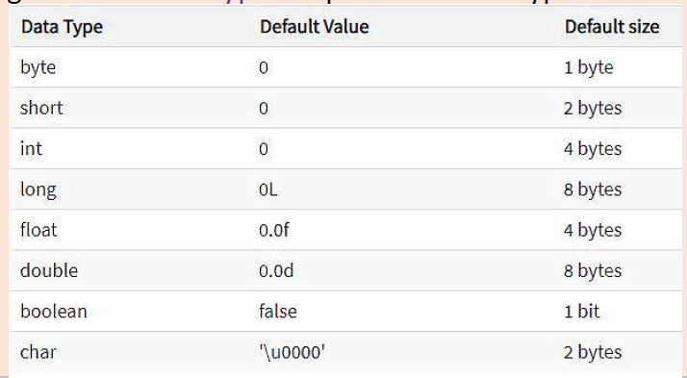
Primitive Data types

Slide 28
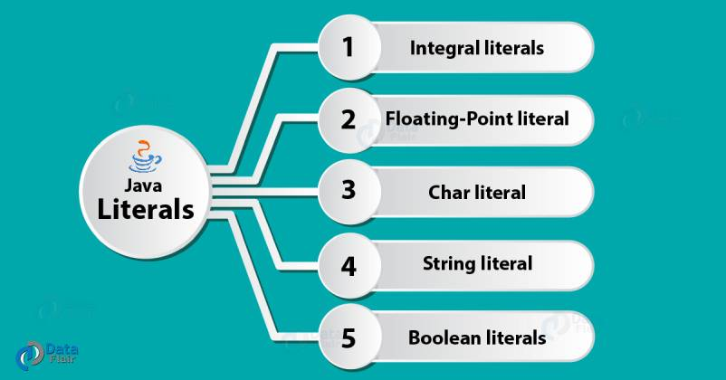
LITERALS IN JAVA
Literals are number, text, or anything that represent a value.
In other words, Literals in Java are the constant values assigned to the variable. It is also called a constant.

Slide 29
LITERALS IN JAVA
Integer Literals
Integer literals create an int value, which in Java is a 32-bit integer value.
Decimal (Base 10) int x = 101;
Octal (Base 8) int x = 0146;
Hexa-Decimal (Base 16) int x = 0X123Face;
Binary int x = 0b1111;
By default, every literal is of int type, we can specify explicitly as long type by suffixed with l or L

Slide 30
LITERALS IN JAVA
Floating-Point Literals
A floating-point literal is of type float if it ends with the letter F or f; otherwise its type is double and it can optionally end with the letter D or d.
The floating point types (float and double) can also be expressed using E or e (for scientific notation), F or f (32-bit float literal) and D or d (64-bit double literal; this is the default and by convention is omitted).
double d1 = 123.4; // same value as d1,
but in scientific notation double d2 = 1.234e2;
float f1 = 123.4f;

Slide 31
LITERALS IN JAVA
Character Literals
Characters in Java are indices into the Unicode character set.
They are 16-bit values (2 byte)that can be converted into integers and manipulated with the integer operators, such as the addition and subtraction operators. A literal character is represented inside a pair of single quotes.
All of the visible ASCII characters can be directly entered inside the quotes, such as ‘a’, ‘z’, and ‘@’.
For characters that are impossible to enter directly, there are several escape sequences.
char character = 'd';

Slide 32
LITERALS IN JAVA
Special Characters
Consider the following example
String txt = "We are the so-called "Vikings" from the north.";
Because strings must be written within quotes, Java will
misunderstand this string.
The solution to avoid this problem, is to use the backslash escape character

Slide 33
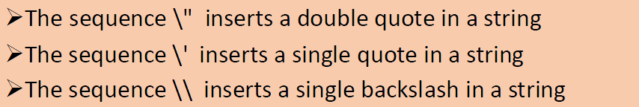
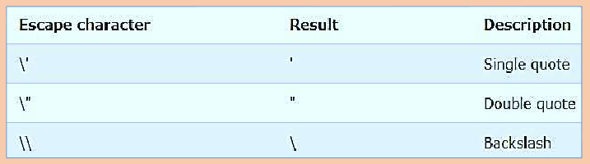
LITERALS IN JAVA
Character Escape Sequences

Slide 34
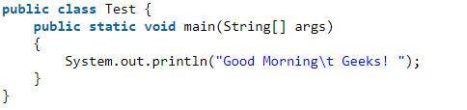
LITERALS IN JAVA
Character Escape Sequences
Output: Hi geek, welcome to "GeeksforGeeks".
Output : Good Morning Geeks!
Output
Good Morning Geeks!
How are you all?

Slide 35
LITERALS IN JAVA
String Literals
String literals in Java are specified like they are in most other languages—by enclosing a sequence of characters between a pair of double quotes.
String s = "Hello";
String myString = "Hello! Welcome to DataFlair";
Boolean Literals
They allow only two values i.e. true and false.
boolean b = true;
boolean boolVar2 = false;

Slide 36
Type Conversion and Casting
If the two types are compatible, then Java will perform the conversion automatically.
For example, it is always possible to assign an int value to a long variable.
However, not all types are compatible, and thus, not all type conversions are implicitly allowed.
For instance, there is no automatic conversion defined from double to byte. Fortunately, it is still possible.
To obtain a conversion between incompatible types., you must use a cast, which performs an explicit conversion between incompatible types.

Slide 37
Java’s Automatic Conversions
When one type of data is assigned to another type of variable, an automatic type conversion will take place if the following two conditions are met:
The two types are compatible.
The destination type is larger than the source type.
When these two conditions are met, a widening conversion takes place.
For example, the int type is always large enough to hold all valid byte values, so no explicit cast statement is required.

Slide 38
Casting Incompatible Types
What if you want to assign an int value to a byte variable? This conversion will not be performed automatically, because a byte is smaller than an int.
This kind of conversion is sometimes called a narrowing conversion, since you are explicitly making the value narrower so that it will fit into the target type.
To create a conversion between two incompatible types, you must use a cast. A cast is simply an explicit type conversion.
It has this general form:
(target-type) value
int a;
byte b;
// ...
b = (byte) a;

Slide 39
TRUNCATION
A different type of conversion will occur when a floating-point value is assigned to an integer type: truncation.
As you know, integers do not have fractional components. Thus,when a floating-point value is assigned to an integer type, the fractional component is lost.
For example, if the value 1.23 is assigned to an integer, the resulting value will simply be 1.
The 0.23 will have been truncated.

Slide 40
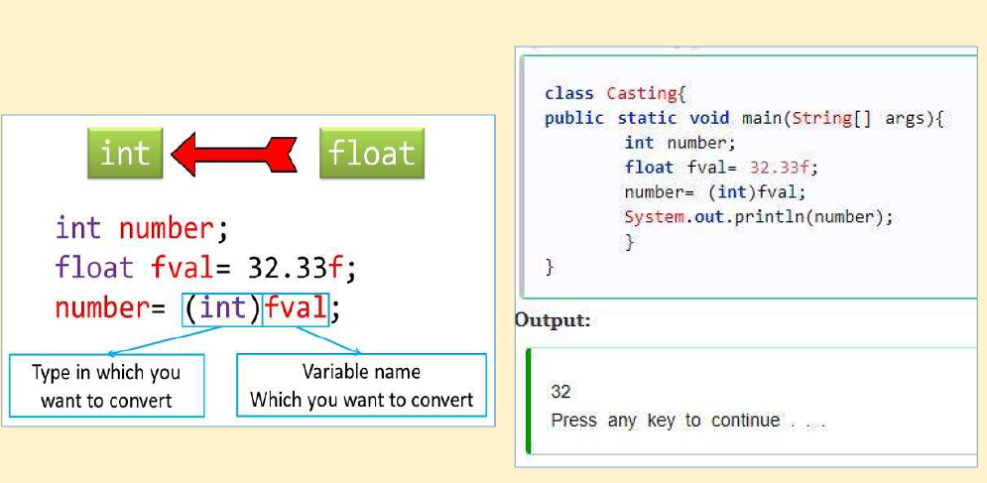
TRUNCATION

Slide 41
Java Type Casting or Type Conversion
➢Type casting is when you assign a value of one primitive data
type to another type.
➢In Java, there are two types of casting:
1. Widening Casting (automatically) – converting a smaller type to a larger type size (called Type Conversion)
byte -> short -> char -> int -> long -> float -> double
2. Narrowing Casting (manually) – converting a larger type to a smaller size type (called Type Casting)
double -> float -> long -> int -> char -> short -> byte

Slide 42
Casting Incompatible Types
class Conversion {
public static void main(String args[]) {
byte b;
int i = 257;
double d = 323.142;
System.out.println("\nConversion of int to byte.");
b = (byte) i;
System.out.println("i and b " + i + " " + b);
System.out.println("\nConversion of double to int.");
i = (int) d;
System.out.println("d and i " + d + " " + i);
System.out.println("\nConversion of double to byte.");
b = (byte) d;
System.out.println("d and b " + d + " " + b);
}
}

Slide 43
Casting Incompatible Types
OUTPUT
Conversion of int to byte.
i and b 257 1
Conversion of double to int.
d and i 323.142 323
Conversion of double to byte.
d and b 323.142 67
When the value 257 is cast into a byte variable, the result is the remainder of the division of 257 by 256 (the range of a byte), which is 1 in this case.
When the d is converted to an int, its fractional component is lost.
When d is converted to a byte, its fractional component is lost, and the value is reduced modulo 256, which in this case is 67.

Slide 44
Automatic Type Promotion in Expressions
Java automatically promotes each byte, short, or char operand to int when evaluating an expression.
byte a = 40;
byte b = 50;
byte c = 100;
int d = a * b / c;
The result of the intermediate term a * b easily exceeds the range of either of its byte operands.
The subexpression a * b is performed using integers—not bytes. Thus, 2,000, the result of the intermediate expression.

Slide 45
Automatic Type Promotion in Expressions
byte b = 50;
b = b * 2; // Error! Cannot assign an int to a byte!
The code is attempting to store 50 * 2, a perfectly valid byte value, back into a byte variable.
However, because the operands were automatically promoted to int when the expression was evaluated, the result has also been promoted to int.
Thus, the result of the expression is now of type int, which cannot be assigned to a byte without the use of a cast.
byte b = 50;
b = (byte)(b * 2); which yields the correct value of 100.

Slide 46
The Type Promotion Rules
First, all byte, short, and char values are promoted to int, as just described. Then, if one operand is a long, the whole expression is promoted to long.
If one operand is a float, the entire expression is promoted to float.
If any of the operands is double, the result is double.

Slide 47
The Type Promotion Rules
class Promote {
public static void main(String args[]) {
byte b = 42;
char c = 'a';
short s = 1024;
int i = 50000;
float f = 5.67f;
double d = .1234;
double result = (f * b) + (i / c) - (d * s);
System.out.println((f * b) + " + " + (i / c) + " - " + (d * s));
System.out.println("result = " + result);
}
}

Slide 48
The Type Promotion Rules
double result = (f * b) + (i / c) - (d * s);
In the first subexpression, f * b, b is promoted to a float and the result of the subexpression is float. Next, in the subexpression i / c, c is promoted to int, and the result is of type int.
Then, in d * s, the value of s is promoted to double, and the type of the subexpression is double.
Finally, these three intermediate values, float, int, and double, are considered. The outcome of float plus an int is a float.
Then the resultant float minus the last double is promoted to double, which is the type for the final result of the expression.

Slide 49
VARIABLES
The variable is the basic unit of storage in a Java program.
A variable is defined by the combination of an identifier, a type, and an optional initializer.
In addition, all variables have a scope, which defines their visibility, and a lifetime.
Declaring a Variable:
The basic form of a variable declaration is shown here:
type identifier [ = value][, identifier [= value] ...] ;
The type is one of Java’s atomic types, or the name of a class or interface.
The identifier is the name of the variable.

Slide 50
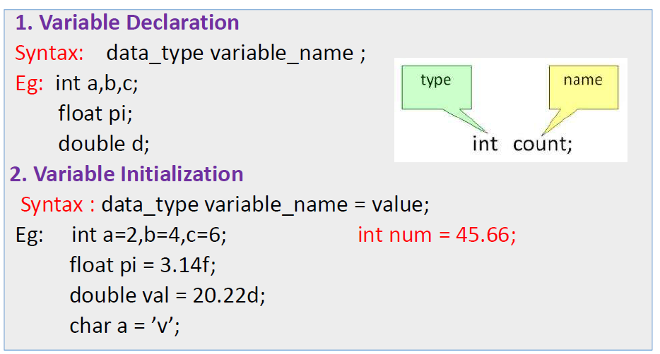
VARIABLES
In order to use a variable in a program we need to perform 2 steps
1. Variable Declaration
2. Variable Initialization

Slide 51
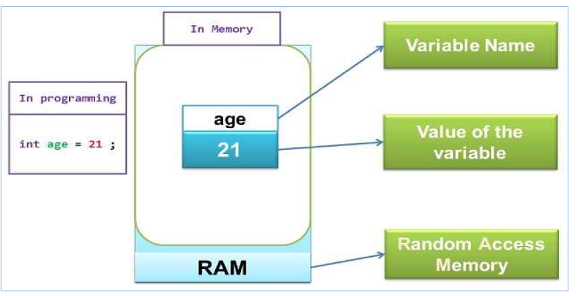
VARIABLES

Slide 52
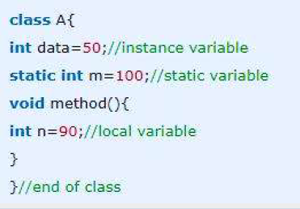
Types of variables
1. Local variables - declared inside the method.
2. Instance Variable - declared inside the class but outside the method.
3. Static variable - declared as with static keyword

Slide 53
Dynamic Initialization
// Demonstrate dynamic initialization.
class DynInit {
public static void main(String args[]) {
double a = 3.0, b = 4.0;
// c is dynamically initialized
double c = Math.sqrt(a * a + b * b);
System.out.println("Hypotenuse is " + c);
}
}

Slide 54
Dynamic Initialization
Here, three local variables—a, b, and c—are declared. The first two, a and b, are initialized by constants.
However, c is initialized dynamically to the length of the hypotenuse (using
the Pythagorean theorem).
The program uses another of Java’s built-in methods, sqrt( ), which is a member of the Math class, to compute the square root of its argument. The key point here is that the initialization expression may use any element valid at the time of the initialization, including calls to methods, other variables, or literals.

Slide 55
The Scope and Lifetime of Variables
So far, all of the variables used have been declared at the start of the main( ) method. However,Java allows variables to be declared within any block.
A block is begun with an opening curly brace and ended by a closing curly brace.
A block defines a scope. Thus, each time you start a new block, you are creating a new scope.
A scope determines what objects are visible to other parts of your program. It also determines the lifetime of those objects.
In Java, the two major scopes are those defined by a class and those defined by a method.
The scope defined by a method begins with its opening curly brace.

Slide 56
The Scope and Lifetime of Variables
As a general rule, variables declared inside a scope are not visible (that is, accessible) to code that is defined outside that scope.
Thus, when you declare a variable within a scope, you are localizing that variable and protecting it from unauthorized access and/or modification.
Indeed, the scope rules provide the foundation for encapsulation.
Scopes can be nested.
The outer scope encloses the inner scope. This means that objects declared in the outer scope will be visible to code within the inner scope.
Objects declared within the inner scope will not be visible outside it.

Slide 57
// Demonstrate block scope.
class Scope {
public static void main(String args[]) {
int x; // known to all code within main
x = 10;
if(x == 10)
{
// start new scope
int y = 20; // known only to this block
// x and y both known here.
System.out.println("x and y: " + x + " " + y);
x = y * 2;
}
// y = 100; // Error! y not known here
// x is still known here.
System.out.println("x is " + x);
} }

Slide 58
The Scope and Lifetime of Variables
// This fragment is wrong!
count = 100; // oops! cannot use count before it is declared!
int count;
Variables are created when their scope is entered, and destroyed when their scope is left.
This means that a variable will not hold its value once it has gone out of scope.
Also, a variable declared within a block will lose its value when the block is left.
Thus, the lifetime of a variable is confined to its scope.
If a variable declaration includes an initializer, then that variable will be reinitialized each time the block in which it is declared is entered.

Slide 59
The Scope and Lifetime of Variables
// Demonstrate lifetime of a variable.
class LifeTime {
public static void main(String args[]) {
int x;
for(x = 0; x < 3; x++) {
int y = -1; // y is initialized each time block is entered
System.out.println("y is: " + y); // this always prints -1
y = 100;
System.out.println("y is now: " + y);
}
}
}

Slide 60
The Scope and Lifetime of Variables
The output generated by this program is shown here:
y is: -1
y is now: 100
y is: -1
y is now: 100
y is: -1
y is now: 100

Slide 61
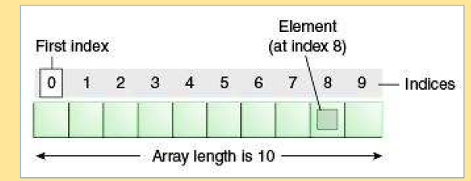
Arrays
Java array is an object which contains elements of a similar data type.
The elements of an array are stored in a contiguous memory location.
The size of an array is fixed and cannot increase to accommodate more elements.
It is also known as static data structure because size of an array must be specified at the time of its declaration.
Array in Java is index-based, the first element of the array is stored at the 0th index.

Slide 62
Arrays
Advantage of Java Array
Code Optimization: It makes the code optimized, we can retrieve or sort the data easily.
Random access: We can get any data located at any index position.
Disadvantage of Java Array
Size Limit: We can store the only fixed size of elements in the array. It doesn't grow its size at runtime. To solve this problem, collection framework is used in java.
Features of Array
It is always indexed. The index begins from 0.
It is a collection of similar data types.
It occupies a contiguous memory location.
Types of Java Array
Single Dimensional Array
Multidimensional Array

Slide 63
One-Dimensional Arrays
A one-dimensional array is, essentially, a list of like-typed variables. To create an array, you first must create an array variable of the desired type. The general form of a one-dimensional array declaration is
type var-name[ ];
type declares the base type of the array.
For example, the following declares an array named monthdays with the type “array of int”:
int monthdays[];
array-var = new type[size];
type specifies the type of data being allocated, size specifies the number of elements in the array, and array-var is the array variable that is linked to the array.

Slide 64
One-Dimensional Arrays
Array Declaration
int[ ] arr;
char[ ] name;
short[ ] arr;
long[ ] arr;
int[ ][ ] arr; //two dimensional array
Initialization of Array
monthdays = new int[12];
int[ ] arr = new int[10]; or int[ ] arr = {10,20,30,40,50};
String[] cars = {"Volvo", "BMW", "Ford", "Mazda"};
double[] myList = new double[10];

Slide 65
One-Dimensional Arrays
Accessing array element
int[ ] arr = {10,24,30,50};
System.out.println("Element at 4th place" + arr[3]);
To find the length of an array, we can use the following syntax:
arrayname.length
Example:
public class MyClass
{
public static void main(String[] args)
{
String[] cars = {"Volvo", "BMW", "Ford", "Mazda"};
System.out.println(cars.length);
}
}

Slide 66
// Demonstrate a one-dimensional array.
class Array {
public static void main(String args[]) {
int month_days[];
month_days = new int[12];
month_days[0] = 31;
month_days[1] = 28;
………………………….
…………………………
month_days[10] = 30;
month_days[11] = 31;
System.out.println("April has " + month_days[3] + " days.");
}
}

Slide 67
// Demonstrate a one-dimensional array.
int monthdays[] = new int[12];
// An improved version of the previous program.
class AutoArray {
public static void main(String args[]) {
int monthdays[] = { 31, 28, 31, 30, 31, 30, 31, 31, 30, 31,30, 31 };
System.out.println("April has " + monthdays[3] + " days.");
}
}

Slide 68
// Average an array of values.
class Average {
public static void main(String args[])
{
double nums[] = {10.1, 11.2, 12.3, 13.4, 14.5};
double result = 0;
int i;
for(i=0; i<5; i++)
{
result = result + nums[i];
}
System.out.println("Average is " + result / 5);
}}

Slide 69
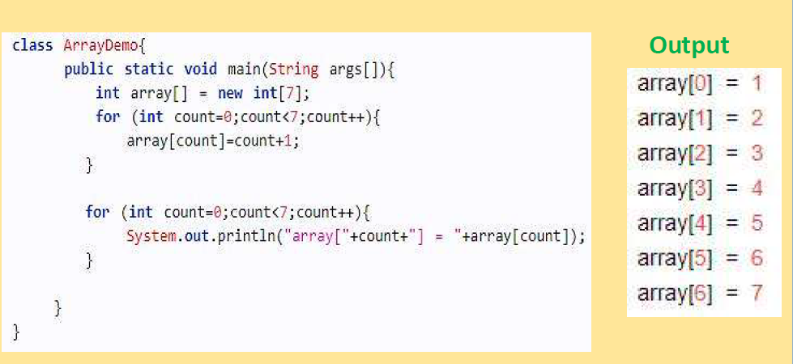
// Example program of Array.

Slide 70
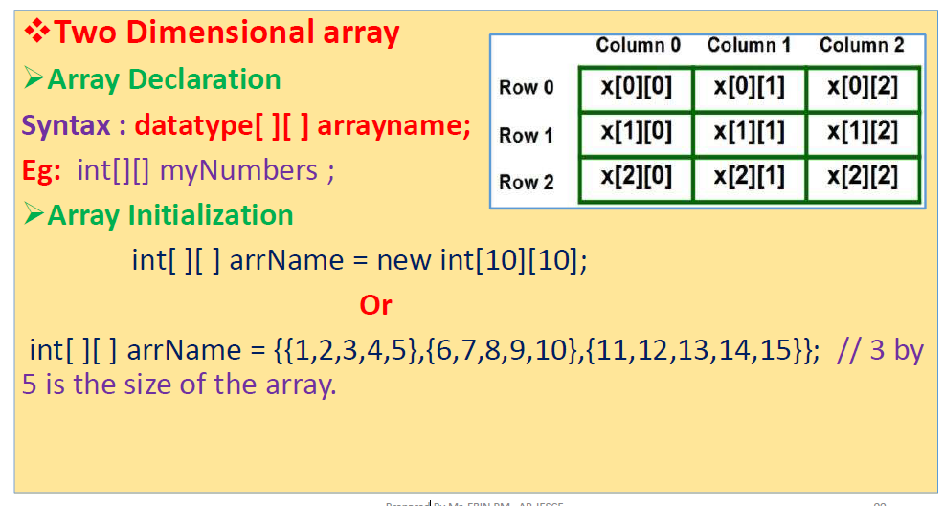
Multidimensional Arrays

Slide 71
Multidimensional Arrays
In Java, multidimensional arrays are actually arrays of arrays.
int twoD[][] = new int[4][5];
This allocates a 4 by 5 array and assigns it to twoD.
// Demonstrate a two-dimensional array.
class TwoDArray {
public static void main(String args[])
{
int twoD[][]= new int[4][5];
int i, j, k = 0;
for(i=0; i<4; i++)
for(j=0; j<5; j++)

Slide 72
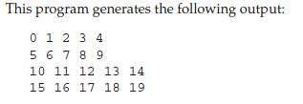
Multidimensional Arrays
{
twoD[i][j] = k;
k++;
}
for(i=0; i<4; i++)
{
for(j=0; j<5; j++)
System.out.print(twoD[i][j] + " ");
System.out.println();
}
}
}

Slide 73
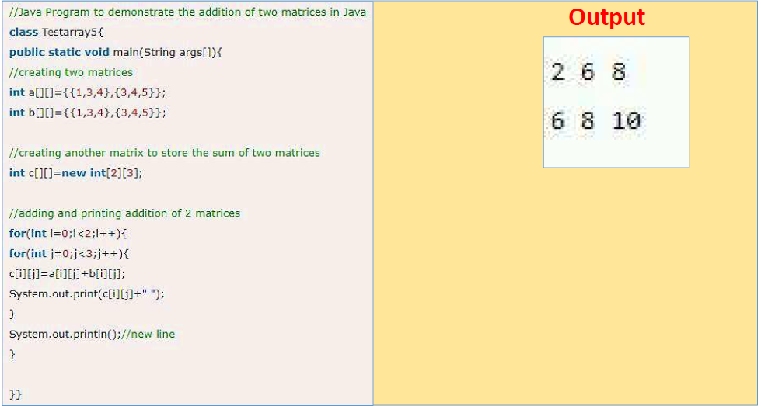
Multidimensional Arrays

Slide 74
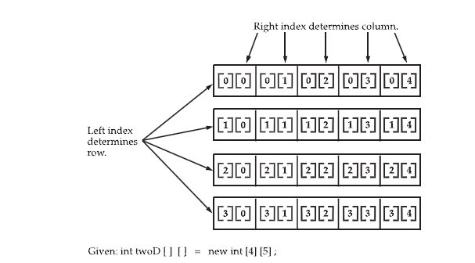
Multidimensional Arrays

Slide 75
Strings
In Java String defines an object.
The String type is used to declare string variables.
You can also declare arrays of strings.
A quoted string constant can be assigned to a String variable. A variable of type String can be assigned to another variable of type String.
String str = "this is a test";
System.out.println(str);
Here, str is an object of type String.
It is assigned the string “this is a test”.
This string is displayed by the println( ) statement.

Slide 76
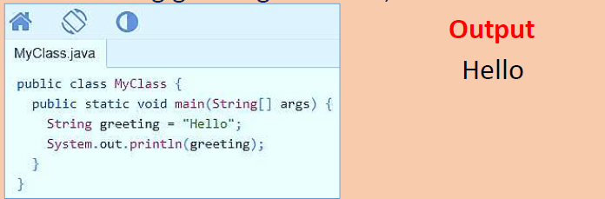
Strings
A String variable contains a collection of characters surrounded by double quotes.
In Java, string is basically an object that represents sequence of char values.
char[] ch={'j',‘o',‘s',‘e',‘p',‘h'};
String s=new String(ch); //converting char array to string is same as
String s="joseph"; //creating string by java string literal

Slide 77
Strings
A String variable contains a collection of characters surrounded by double quotes.
In Java, string is basically an object that represents sequence of char values.
char[] ch={'j',‘o',‘s',‘e',‘p',‘h'};
String s=new String(ch); //converting char array to string is same as
String s="joseph"; //creating string by java string literal

Slide 78
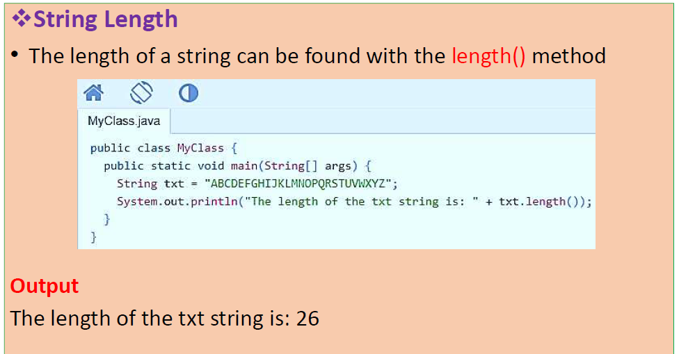
Strings

Slide 79
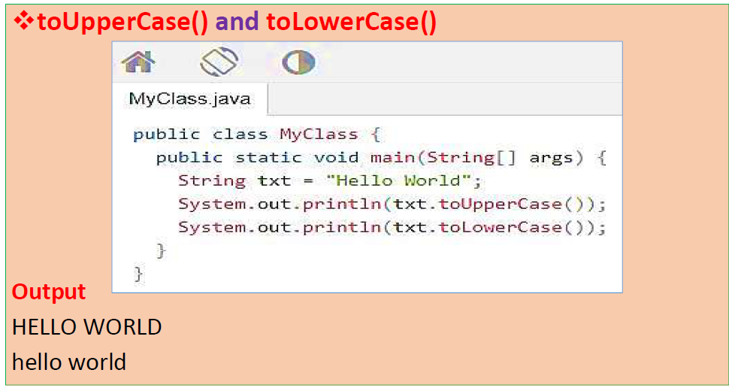
Strings

Slide 80
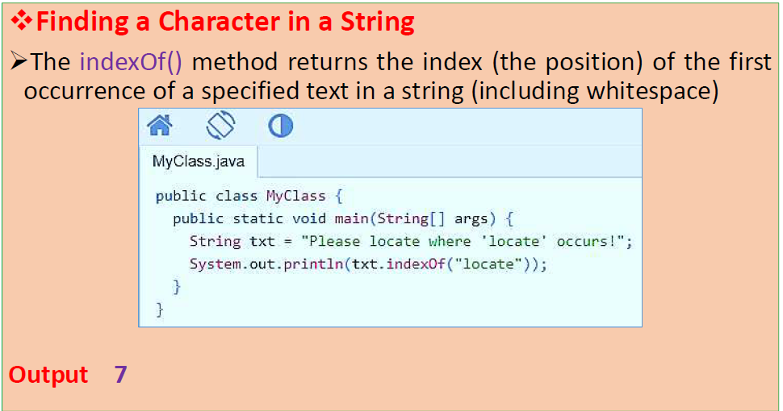
Strings

Slide 81
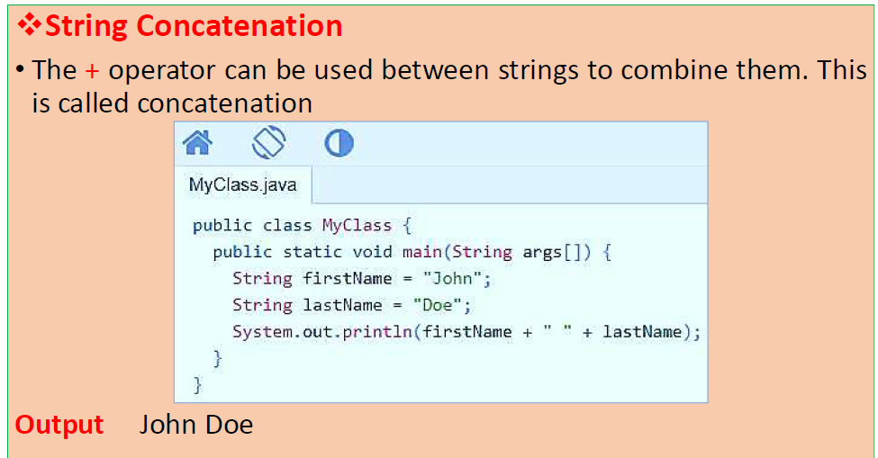
Strings

Slide 82
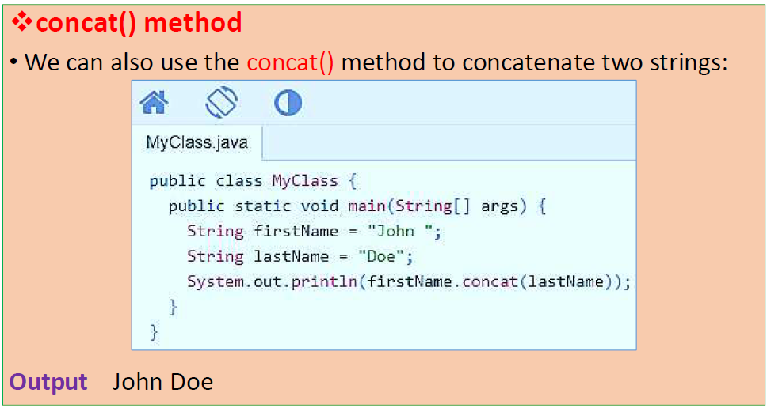
Strings

Slide 83
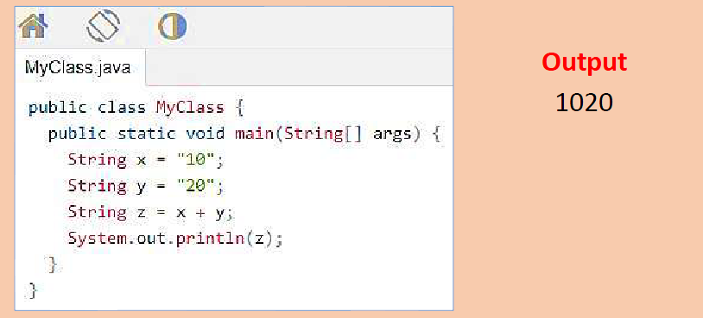
Strings
Adding Numbers and Strings
Java uses the + operator for both addition and concatenation.
If we add two strings, the result will be a string concatenation.

Slide 84
Strings
Adding Numbers and Strings
Java uses the + operator for both addition and concatenation.
If we add two strings, the result will be a string concatenation.

Slide 85
Scanner class in Java supports nextInt(), nextLong(), nextDouble() etc. But there is no nextChar() (See this for examples)
To read a char, we use next().charAt(0). next() function returns the next token/word in the input as a string and charAt(0) function returns the first character in that string.

Slide 86
import java.util.Scanner;
class ScannerDemo1
{
public static void main(String[] args)
{
// Declare the object and initialize with
// predefined standard input object
Scanner sc = new Scanner(System.in);
// Character input
char c = sc.next().charAt(0);
// Print the read value
System.out.println("c = "+c);
}
}

Slide 87
Vector Class
Vector is like the dynamic array which can grow or shrink its size.
Unlike array, we can store n-number of elements in it as there is no size limit.
It is a part of Java Collection framework since Java 1.2.
It is found in the java.util package and implements the List interface, so we can use all the methods of List interface here.
Java Vector Constructors
vector() -It constructs an empty vector with the default size as 10.
vector(int initialCapacity) -It constructs an empty vector with the specified initial capacity.
vector(int initialCapacity, int capacityIncrement) -It constructs an empty vector with the specified initial capacity and capacity increment.

Slide 88
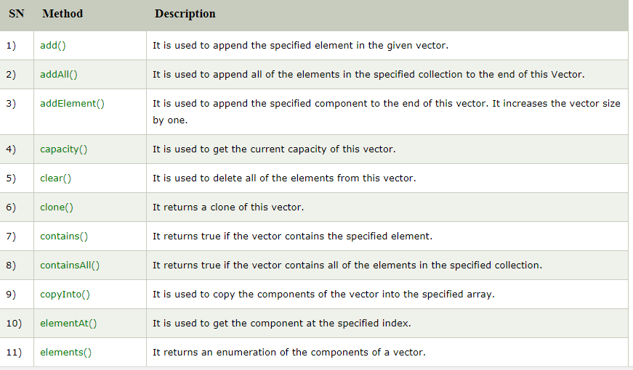
Java Vector Methods

Slide 89
Java Vector Example
import java.util.*;
public class VectorExample {
public static void main(String args[]) {
//Create a vector
Vector<String> vec = new Vector<String>();
//Adding elements using add() method of List
vec.add("Tiger");
vec.add("Lion");
vec.add("Dog");
vec.add("Elephant");

Slide 90
Java Vector Example
//Adding elements using addElement() method of Vector
vec.addElement("Rat");
vec.addElement("Cat");
vec.addElement("Deer");
System.out.println("Elements are: "+vec);
} }
OUTPUT
Elements are: [Tiger, Lion, Dog, Elephant, Rat, Cat, Deer]

Slide 91
Java Vector Example
import java.util.*;
public class VectorExample1 {
public static void main(String args[]) {
//Create an empty vector with initial capacity 4
Vector<String> vec = new Vector<String>(4);
//Adding elements to a vector
vec.add("Tiger");
vec.add("Lion");
vec.add("Dog");
vec.add("Elephant");
//Check size and capacity
System.out.println("Size is: "+vec.size());
System.out.println("Default capacity is: "+vec.capacity());
//Display Vector elements
System.out.println("Vector element is: "+vec);

Slide 92
Java Vector Example
vec.addElement("Rat");
vec.addElement("Cat");
vec.addElement("Deer");
//Again check size and capacity after two insertions
System.out.println("Size after addition: "+vec.size());
System.out.println("Capacity after addition is: "+vec.capacity());
//Display Vector elements again
System.out.println("Elements are: "+vec);
//Checking if Tiger is present or not in this vector
if(vec.contains("Tiger"))
{
System.out.println("Tiger is present at the index " +vec.indexOf("Tiger"));
}

Slide 93
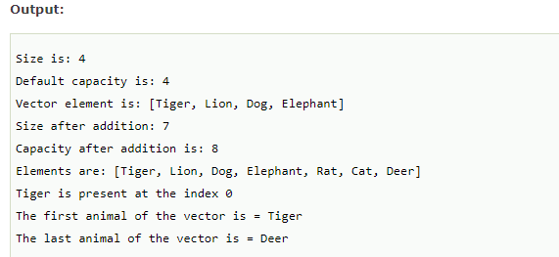
Java Vector Example
else
{
System.out.println("Tiger is not present in the list.");
}
//Get the first element
System.out.println("The first animal of the vector is = "+vec.firstElement());
//Get the last element
System.out.println("The last animal of the vector is = "+vec.lastElement());
}
}

Slide 94
Summary
There are 8 primitive data types in Java.
If the two types are compatible, then Java will perform the conversion automatically.
To create a conversion between two incompatible types, you must use a cast. A cast is simply an explicit type conversion.
The variable is the basic unit of storage in a Java program.
A scope determines what objects are visible to other parts of your program. It also determines the lifetime of those objects.

Slide 95
Thanks!
Any questions?

